Slide 1
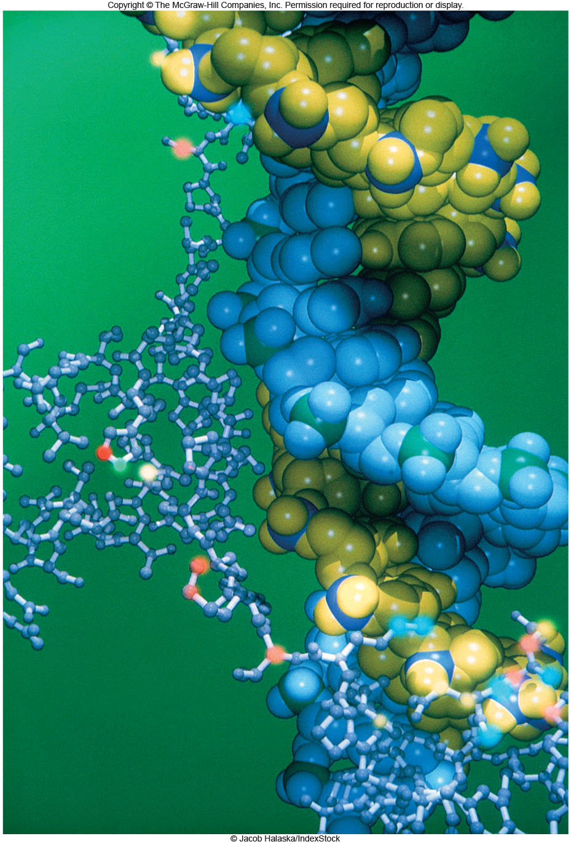
The Chemical Building
Blocks of Life
Chapter 5

Slide 2
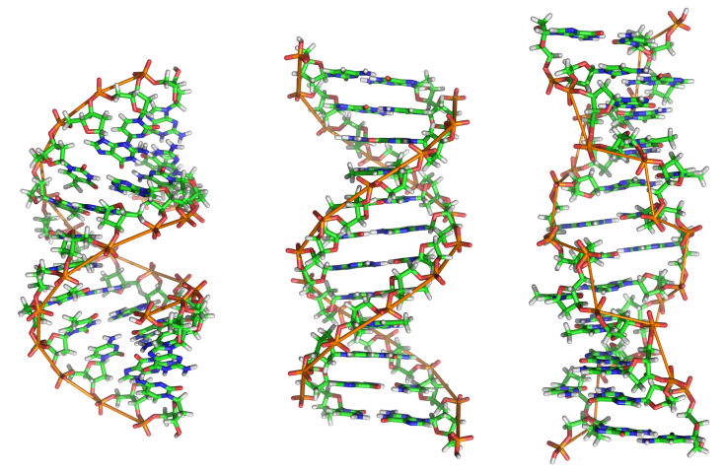
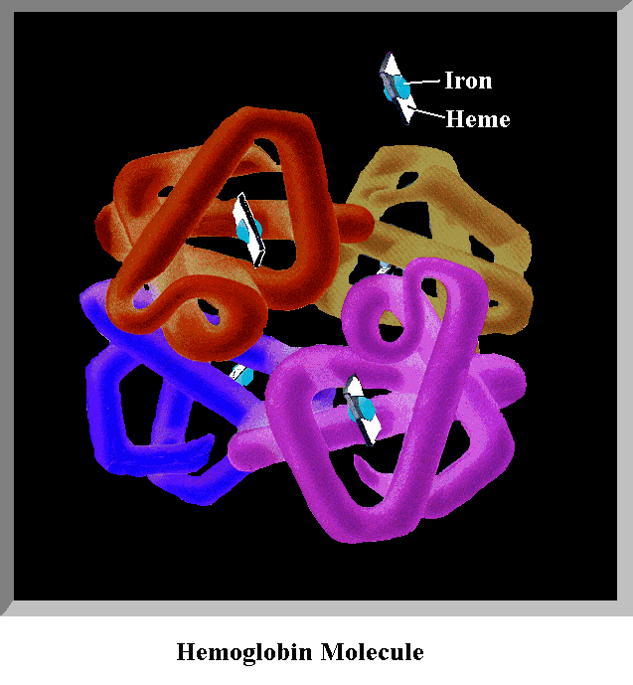
Biological Molecules
"macro“ = big
Made of few, common atoms
Accomplish all life functions
typically large molecules constructed from smaller subunits
Monomer: single subunit
  (mono = 1; -mer = unit)
Polymer: many units
  (poly = many)

Slide 3
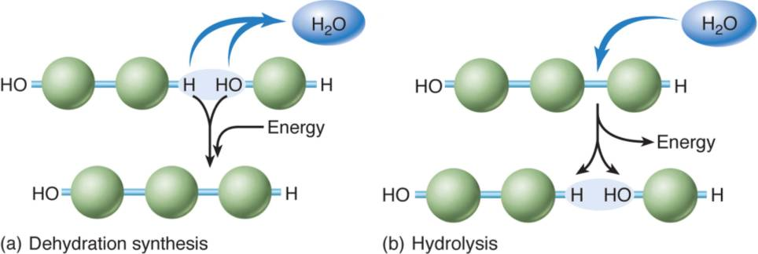
Dehydration Synthesis
dehydration synthesis: formation of large molecules by the removal of water
  Water is produced!
Builds complexity ("anabolic")
Requires energy ("endothermic") & enzymes

Slide 4
Hydrolysis
hydrolysis: breakdown of large molecules by the addition of water
  lysis = "breaking“
  Water is needed!
Reduces complexity ("catabolic")
Releases energy ("exothermic")
Enzymes still required!

Slide 5
Carbohydrates
Monomers = "monosaccharides“
  examples: sugars, starch, glucose
Made of C, H, and O (1:2:1 ratio)
  empirical formula: (CH₂O)_{n}
Short term energy storage & structure
  C – H covalent bonds hold much energy

Slide 6
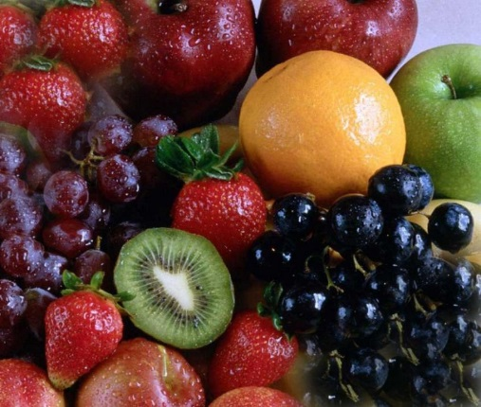
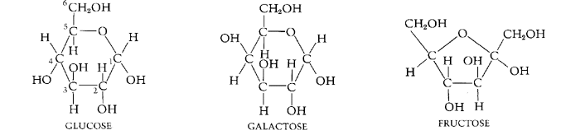
Carbohydrates
monosaccharide – single 6 carbon sugar
  simple sugars
very important in energy storage
  immediate energy
  Fruits, cookie, candy, honey
fructose = structural isomer of glucose
galactose = stereoisomer of glucose

Slide 7
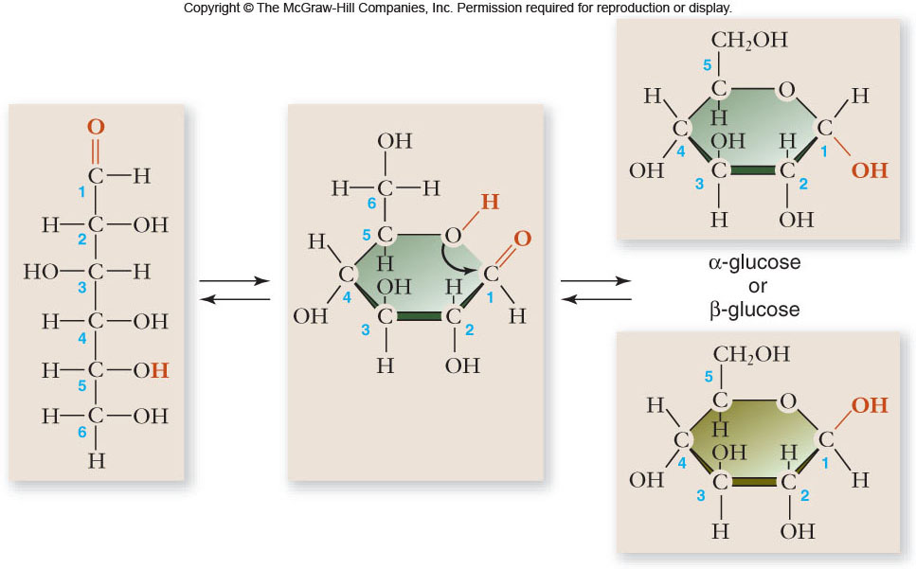
Carbohydrates
OH group down
OH group up

Slide 8
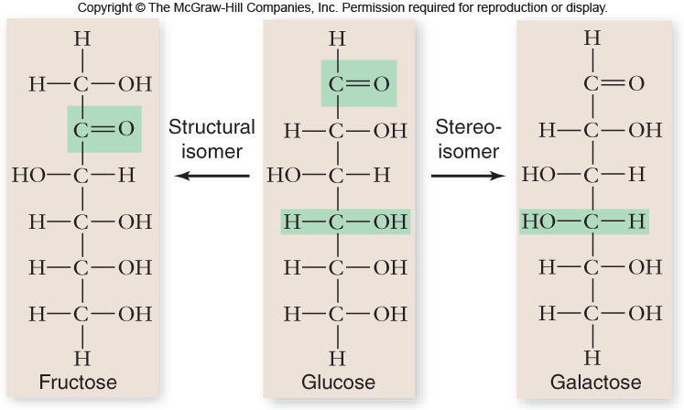
Carbohydrates

Slide 9
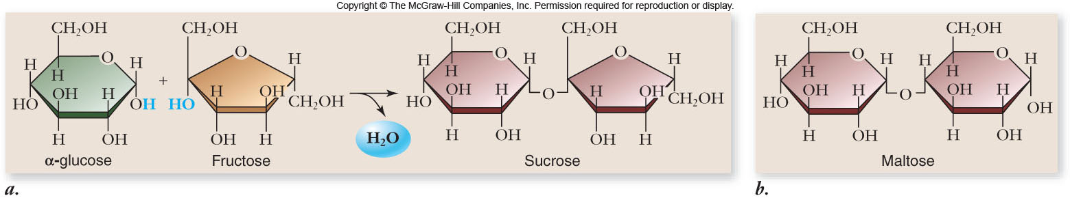
Disaccharides
2 monosaccharides linked together
  dehydration synthesis (forms glycosidic bond)
  Includes lactose (milk), sucrose (table sugar), maltose (starch)
  provide sweet taste and quick energy
used for sugar transport or energy storage

Slide 10
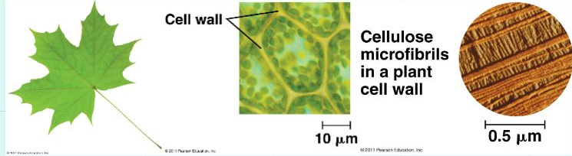
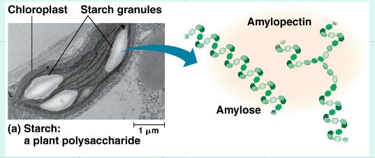
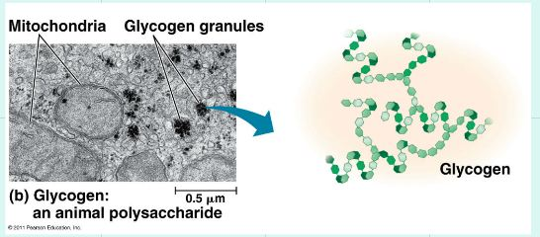
Polysaccharides
Massive polymers of sugars are called "polysaccharides"
Glucose polymers have two main functions in organisms
Energy Storage
Structural Support
Polysaccharides = short term energy storage
Plants: amylose (starch)
Animals: glycogen
Cellulose is major component of plant-like cell walls
The difference between starch and cellulose is in the linkages between glucose units
Starch = alpha linked
Cellulose = beta linked
animals use chitin

Slide 11
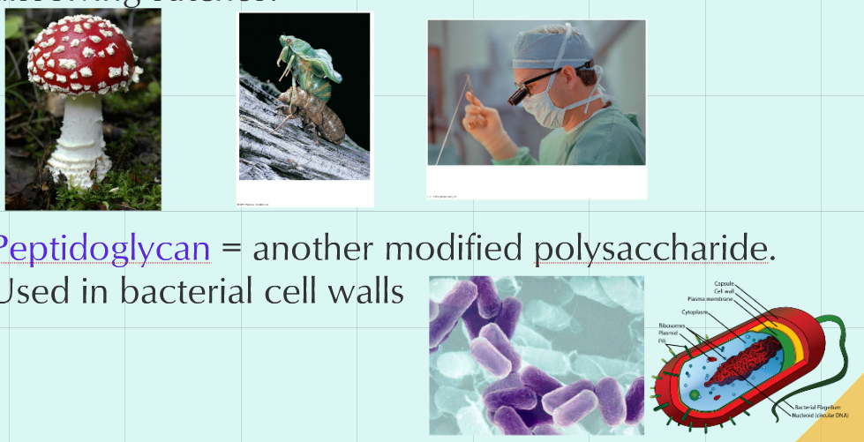
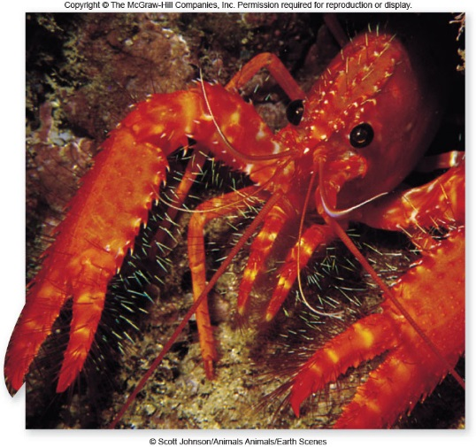
Other Carbohydrates
Chitin = a modified polysaccharide
  Used in fungi cell walls, arthropod exoskeletons, and dissolving stitches!
Peptidoglycan = another modified polysaccharide
  Used in bacterial cell walls

Slide 12
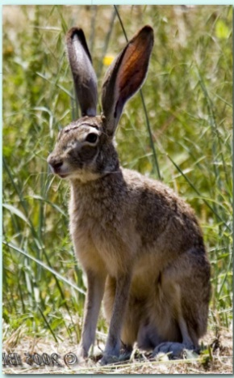
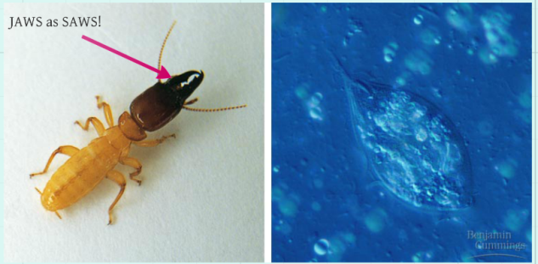
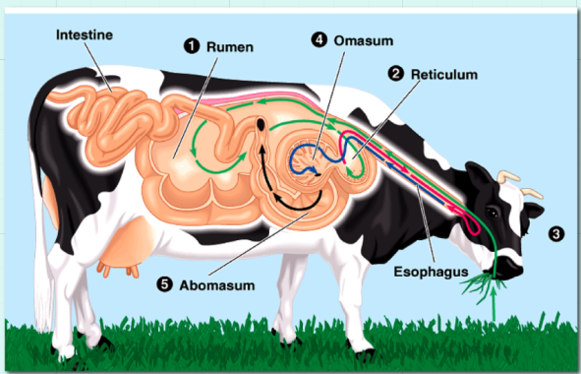
Problem with Herbivory
Herbivores need to digest cellulose
Animals lack the enzymes necessary to break beta linkages
Several strategies are employed
Termites
Have a symbiotic relationship with a protist.
In exchange for a place to live (the termite gut), the protist does the cellulose digestion
Ruminants (Cows)
vastly expanded upper GI tract. The action of bacteria, and continual regurgitation and chewing of "cud" leads to the digestion of cellulose
Caecophores like bunnies have an expanded lower GI tract. Food can not be regurgitated, but there is still a way to put partially digested cellulose back in to the animal...

Slide 13
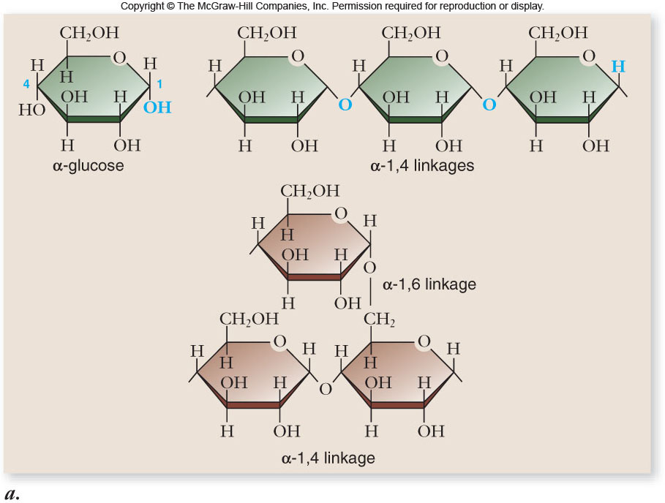
Carbohydrates

Slide 14
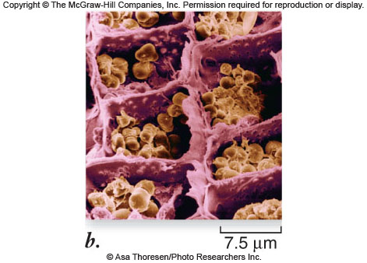
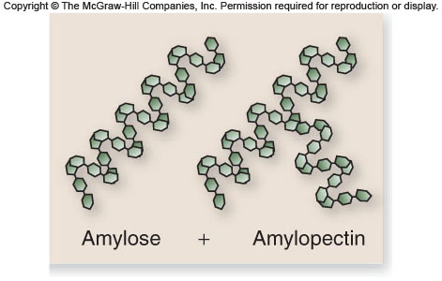
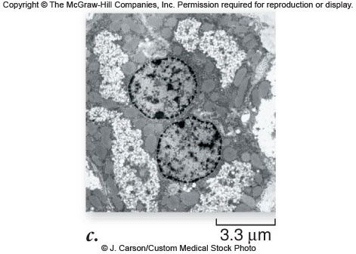
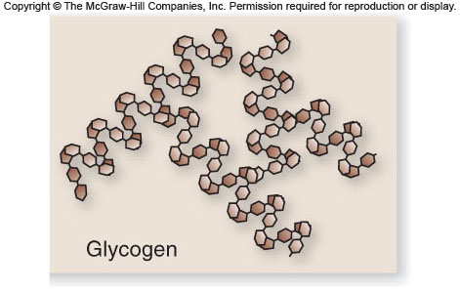
Carbohydrates

Slide 15
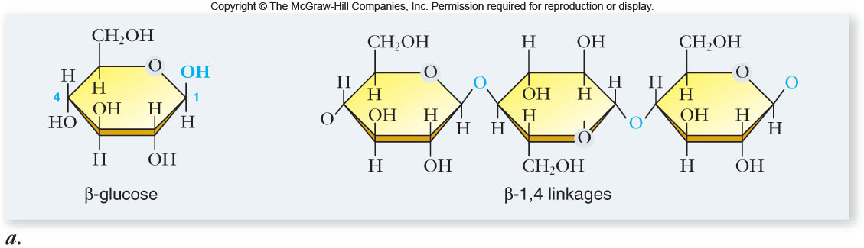
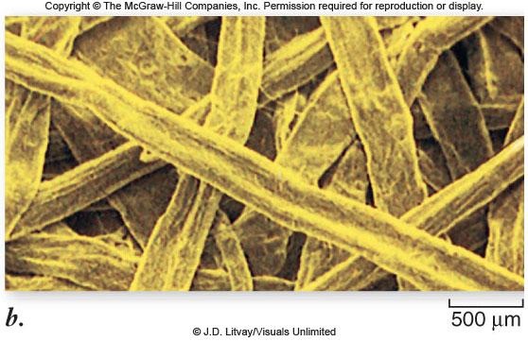
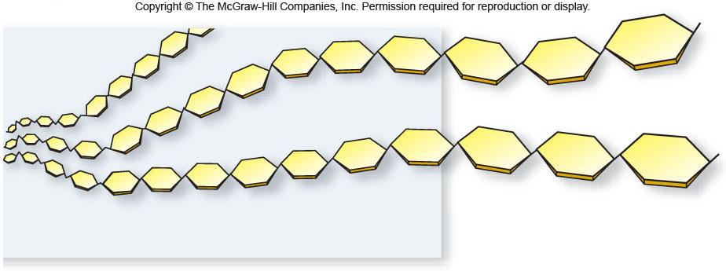
Carbohydrates

Slide 16
Nucleic Acids
Two types: DNA and RNA
Functions: specialized for the storage, transmission, and use of genetic information
Monomer = nucleotide
  sugar + phosphate + nitrogenous base
  sugar is deoxyribose in DNA or ribose in RNA
Nitrogenous bases include
  purines: adenine and guanine
  pyrimidines: thymine, cytosine, uracil

Slide 17
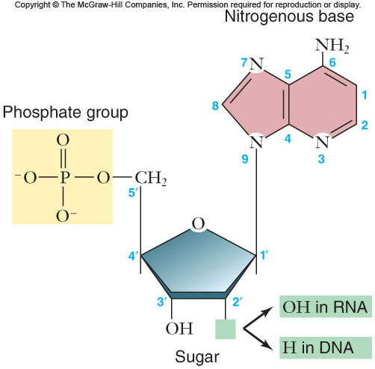
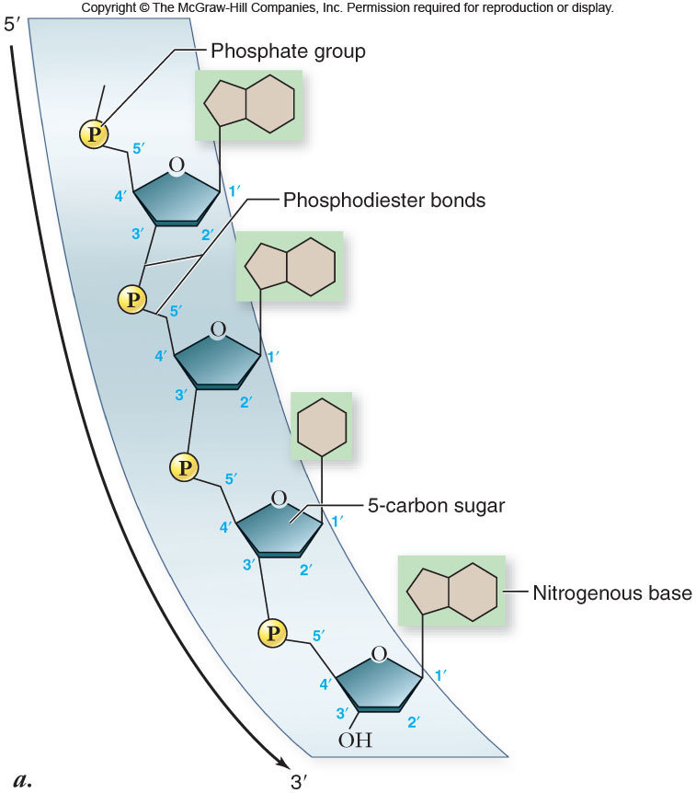
Nucleic Acids

Slide 18
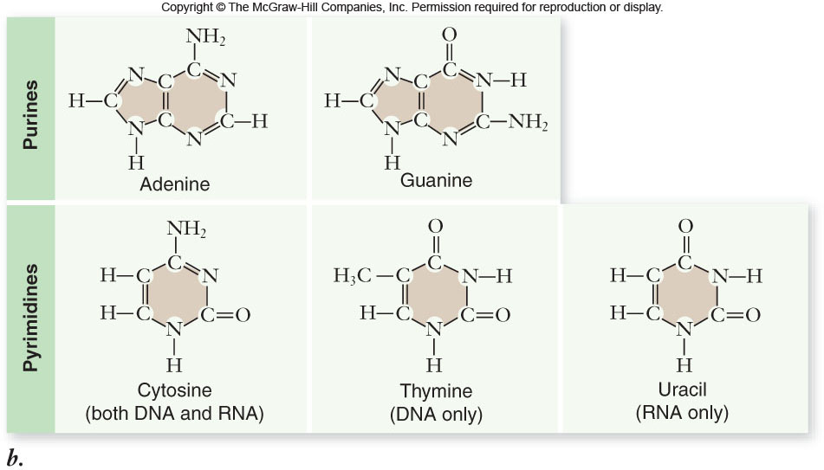
Nucleic Acids

Slide 19
Nucleic Acids
DNA
nucleotides connected by phosphodiester bonds
double helix: 2 polynucleotide strands connected by hydrogen bonds
polynucleotide strands are complementary
genetic information is carried in the sequence of nucleotides

Slide 20
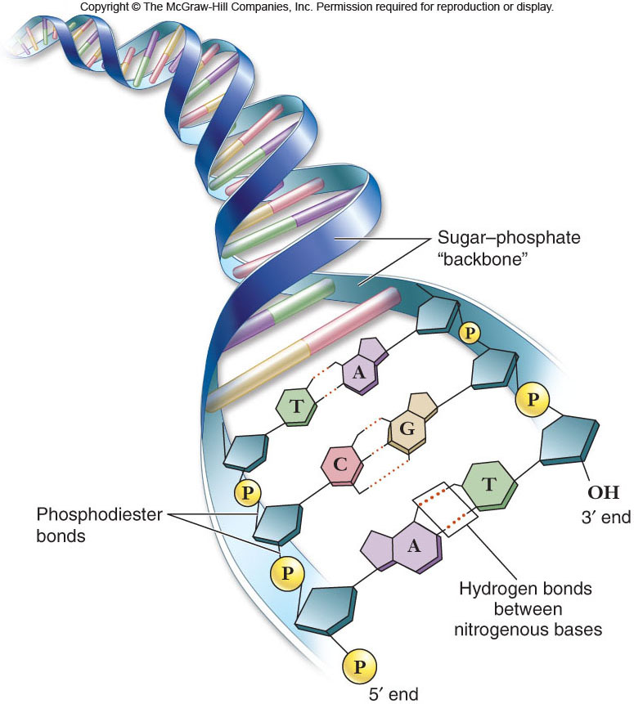
Nucleic Acids

Slide 21
Nucleic Acids
RNA
contains ribose instead of deoxyribose
contains uracil instead of thymine
single polynucleotide strand
functions:
  read the genetic information in DNA
  direct the synthesis of proteins

Slide 22
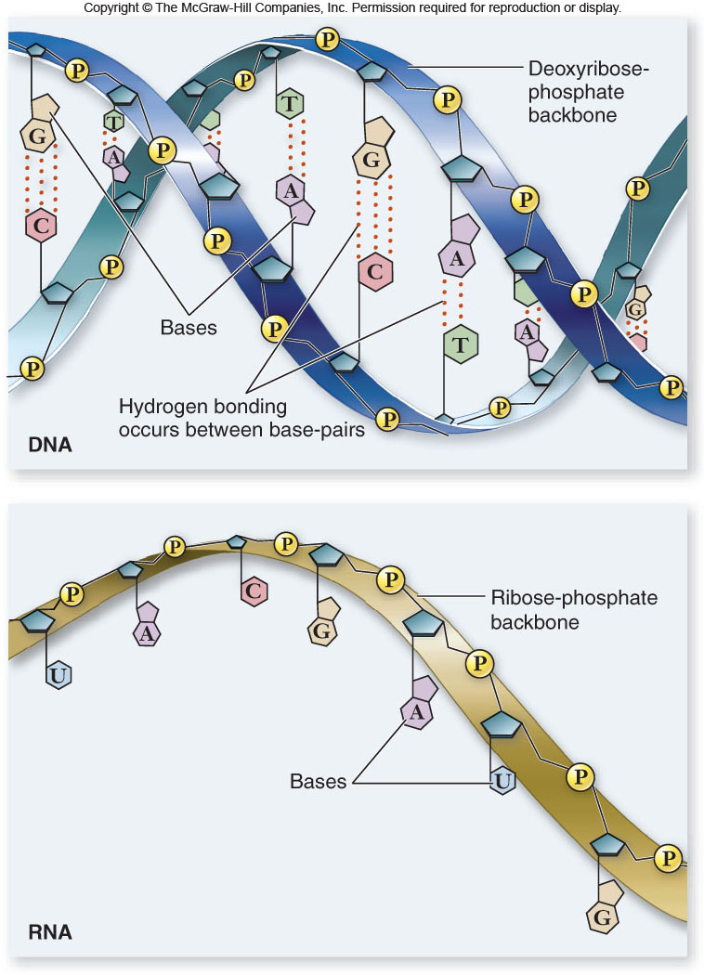
Nucleic Acids

Slide 23
Nucleic Acids
Other nucleotides
ATP: adenosine triphosphate
  primary energy currency of the cell
NAD⁺ and FAD: electron carriers for many cellular reactions

Slide 24
Proteins
Protein functions include:
1. enzyme catalysts
2. defense
3. transport
4. support
5. motion
6. regulation
7. storage

Slide 25
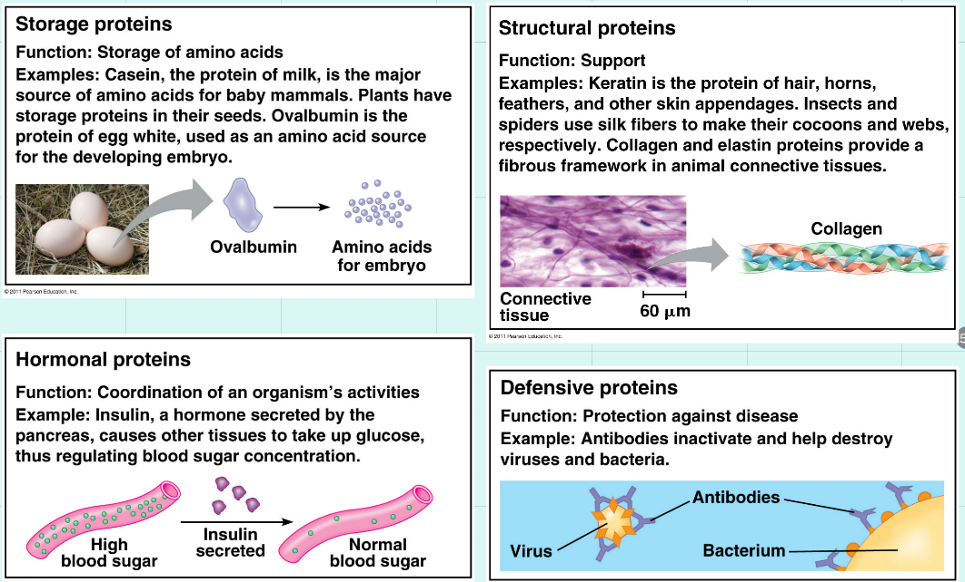

Slide 26
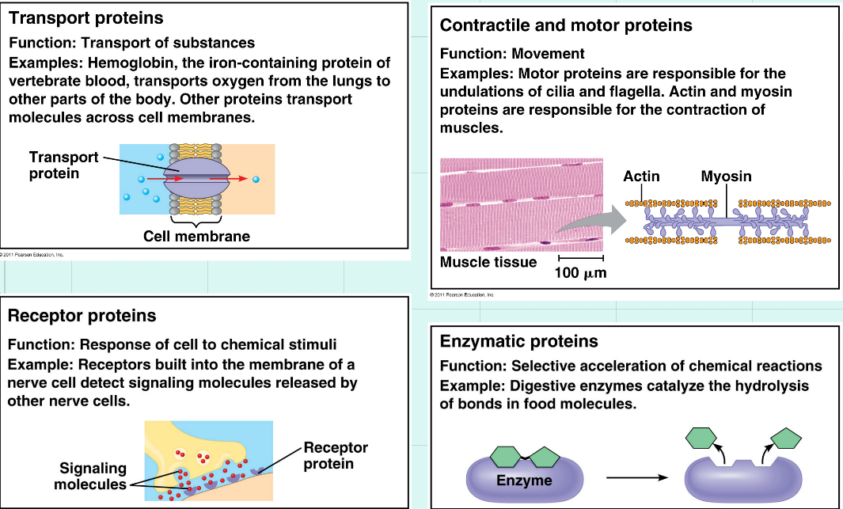

Slide 27
Proteins
Proteins are polymers of amino acids.
Amino acids
  20 different amino acids
  joined by dehydration synthesis
  peptide bonds form between adjacent amino acids

Slide 28
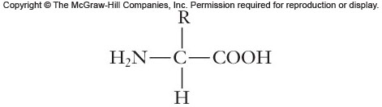
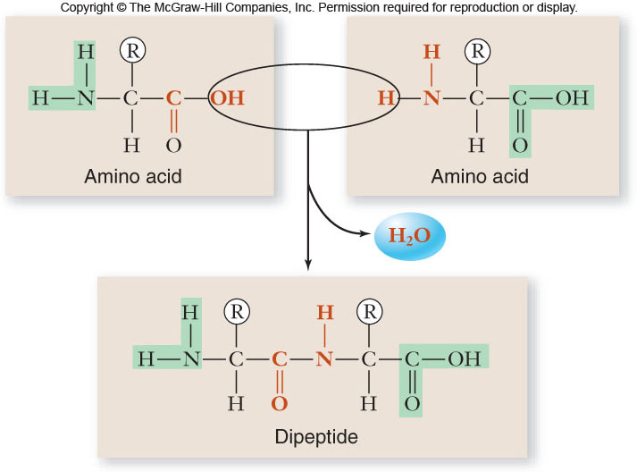
Amino acid structure
central carbon atom surrounded by
  amino group
  carboxyl group
  single hydrogen
  variable R group

Slide 29
Proteins
The structure of the R group dictates the chemical properties of the amino acid.
Amino acids can be classified as:
1. nonpolar
2. polar
3. charged
4. aromatic
5. special function

Slide 30
Proteins
The shape of a protein determines its function.
-primary structure – sequence of amino acids
-secondary structure – interaction of groups in the peptide backbone
-α helix
-β sheet

Slide 31
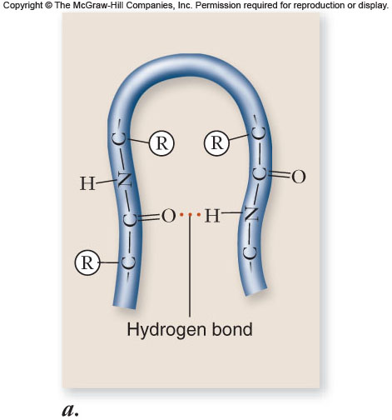
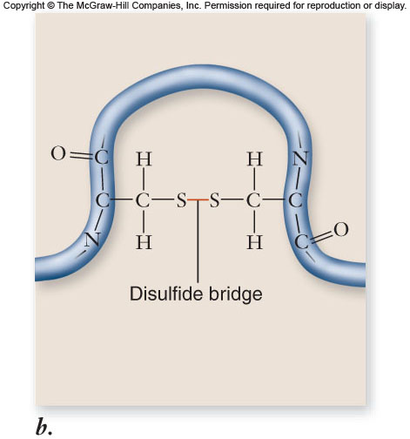
Proteins

Slide 32
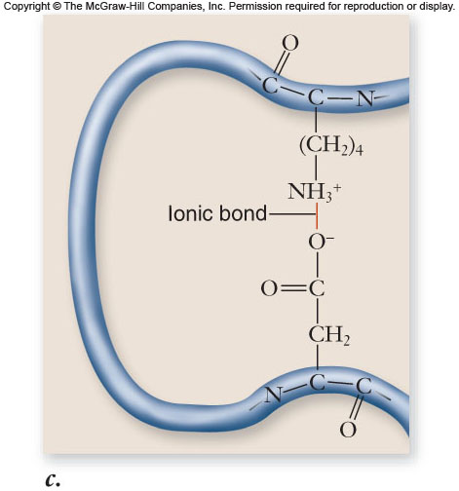
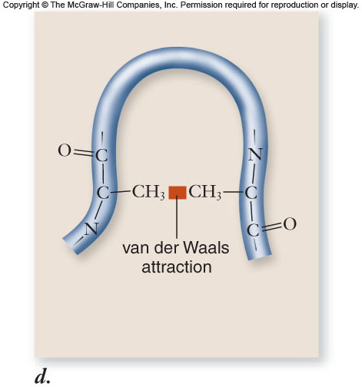
Proteins

Slide 33
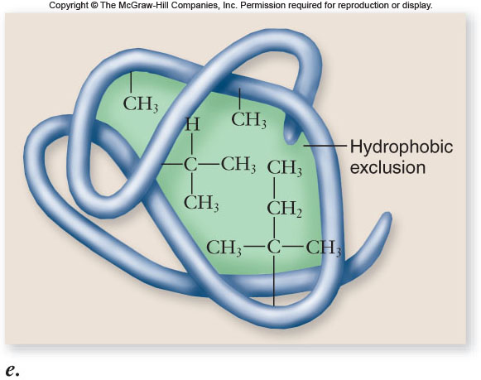
Proteins

Slide 34
Proteins
Protein structure (continued)
tertiary structure – folded shape of the polypeptide chain
quaternary structure – interactions between multiple polypeptide subunits
Protein folding is aided by chaperone proteins

Slide 35
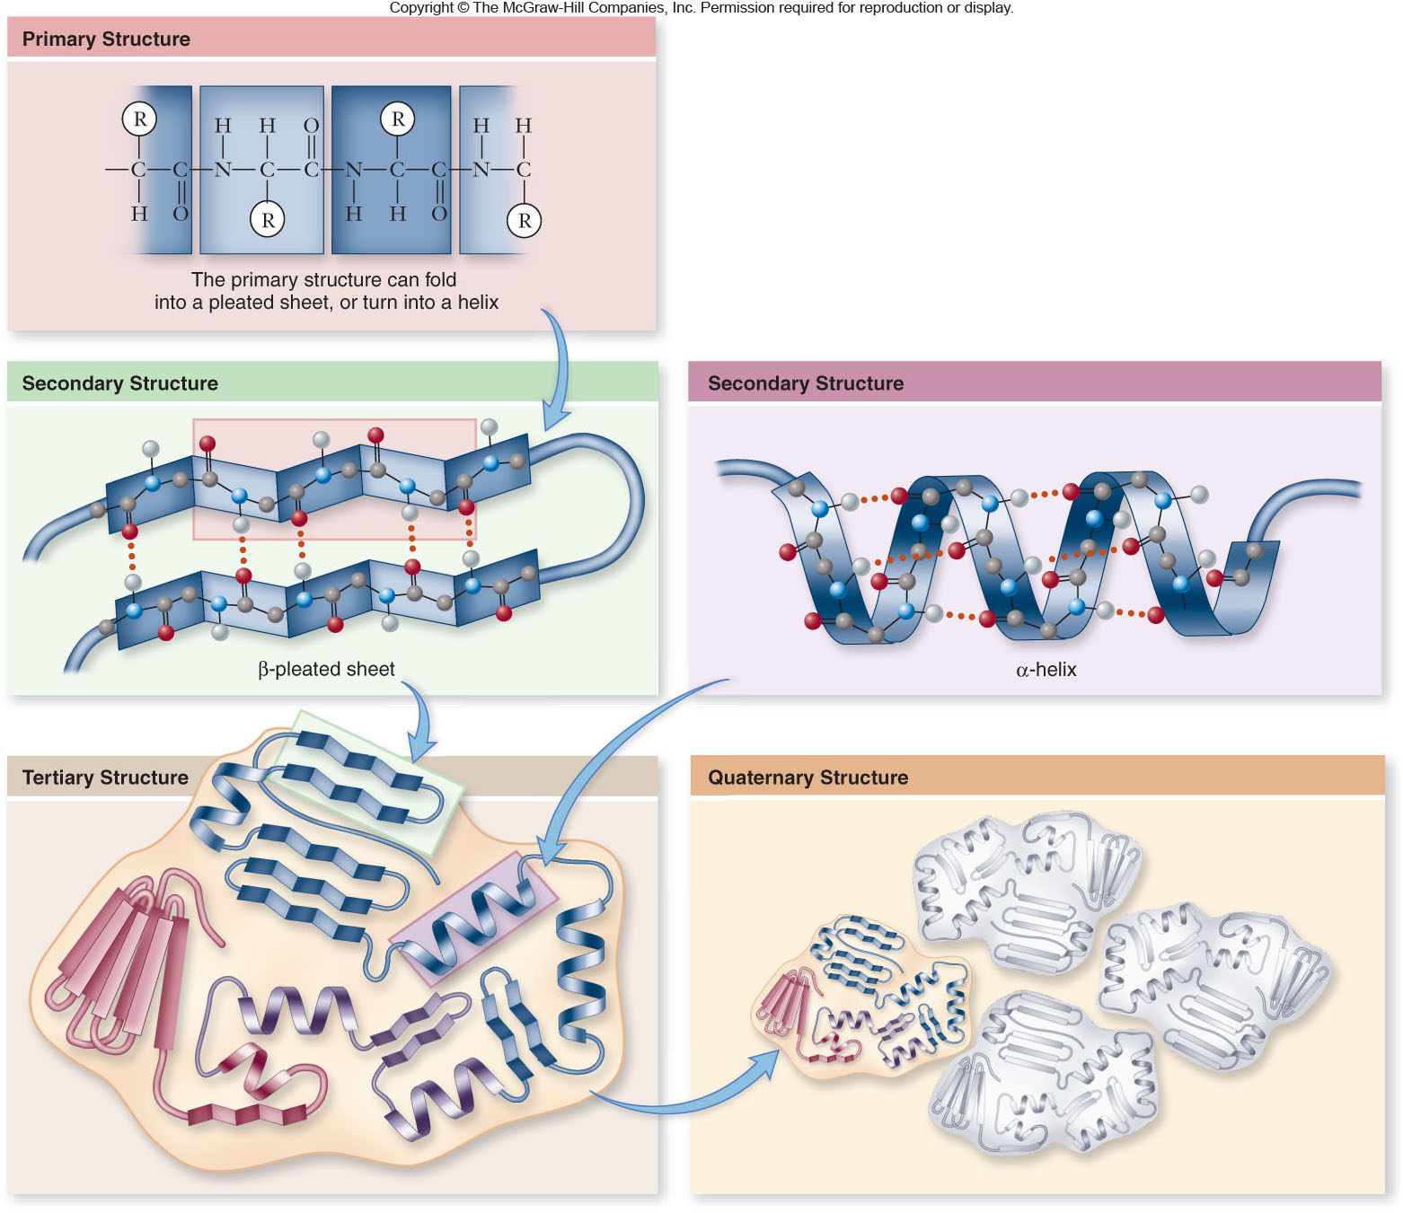
Proteins

Slide 36
Proteins
Motifs are common elements of secondary structure seen in many polypeptides.
Domains are functional regions of a polypeptide.

Slide 37
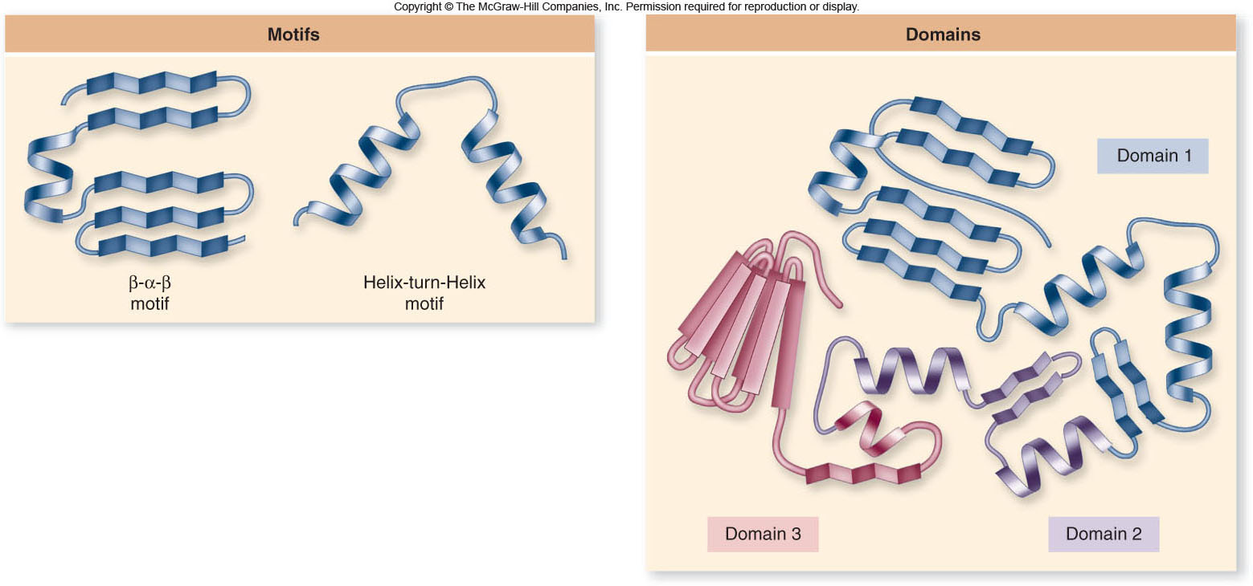
Proteins

Slide 38
Proteins
Denaturation is a change in the shape of a protein, usually causing loss of function.
may involve complete unfolding
caused by changes in the protein’s environment
  pH
  temperature
  salt concentration

Slide 39
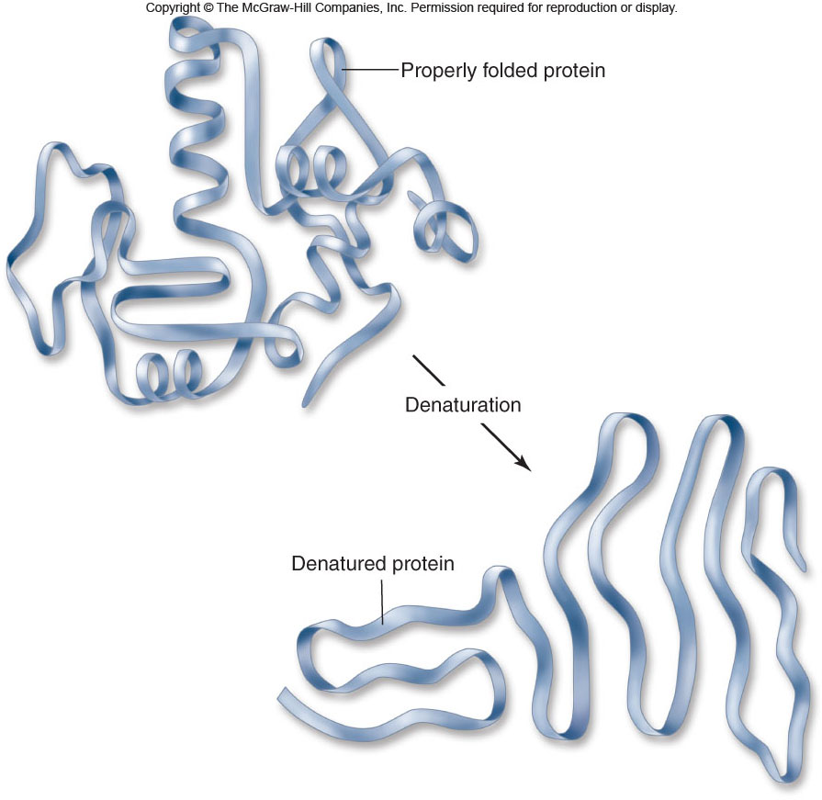
Proteins

Slide 40
Lipids
Lipids are a group of molecules that are insoluble in water. ( Fats, oils, waxes)
A high proportion of nonpolar C – H bonds causes the molecule to be hydrophobic.
3 major groups: triglycerides, phospholipids, & steroid
Long term energy storage & insulation

Slide 41
Lipids
Triglycerides (fats)
  composed of 1 glycerol + 3 fatty acids
  Simple lipid
Fatty acids are long hydrocarbon chains which may be
-saturated
-unsaturated
-polyunsaturated
Fats come from saturated fatty acids; oils come from unsaturated fatty acids.

Slide 42
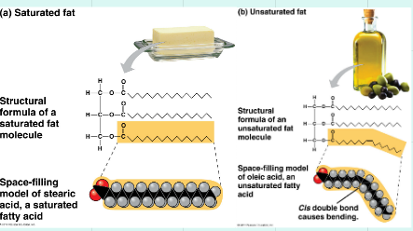
Saturated and Unsaturated
Refers to the bonding of carbon in the fatty acids
Saturated = no double bonds (fats)
Unsaturated = at least one double bond (oils)
Influences shape which influences properties
Oils vs. fats
Which ones stay liquid at lower temperatures? Why?
Which ones are healthier for you? Why?

Slide 43
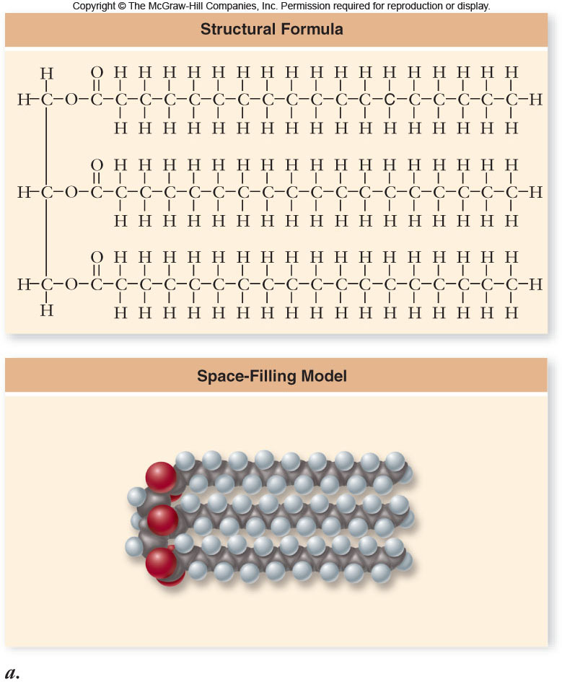
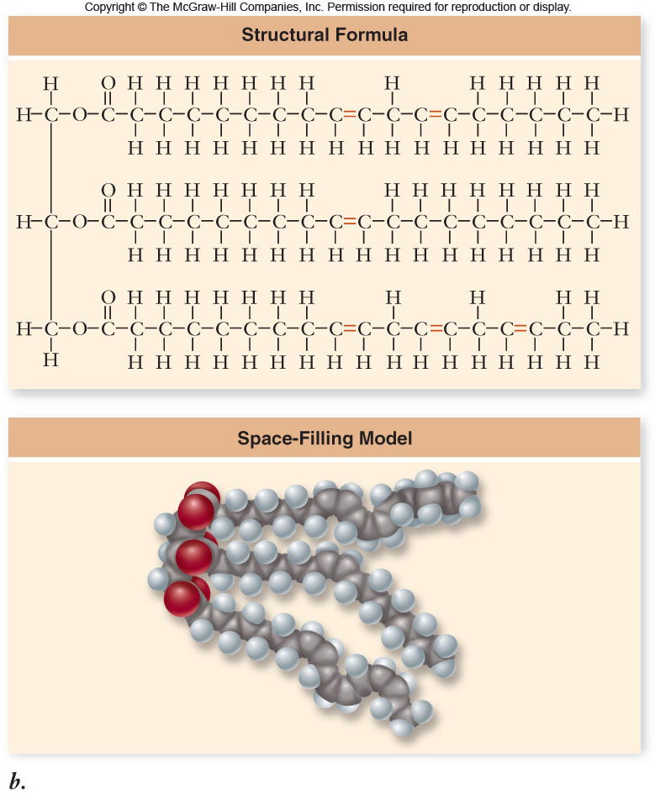
Lipids

Slide 44
Lipids
Triglycerides
  an excellent molecule for energy storage
  store twice as much energy as carbohydrates
  animal fats are usually saturated fats and are solid at room temperature
  plant fats (oils) are usually unsaturated and are liquid at room temperature

Slide 45
Lipids
Phospholipids -composed of:
  1 glycerol
  2 fatty acids
  a phosphate group
Phospholipids contain polar “heads” and nonpolar “tails”.

Slide 46
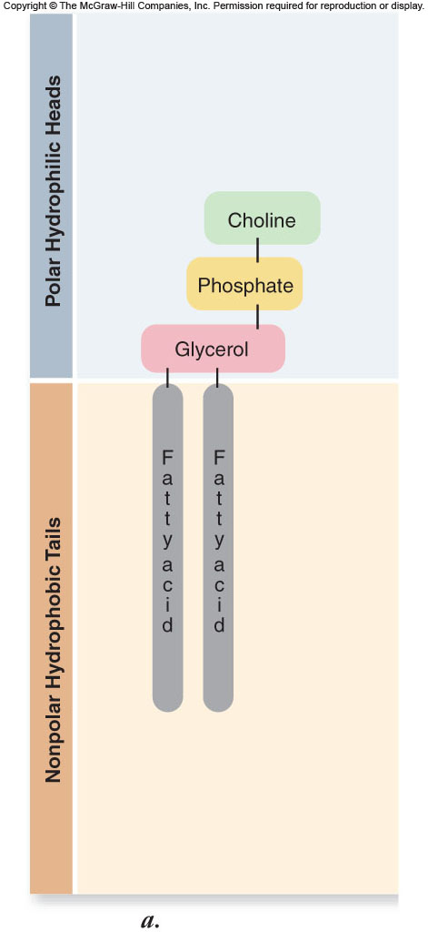
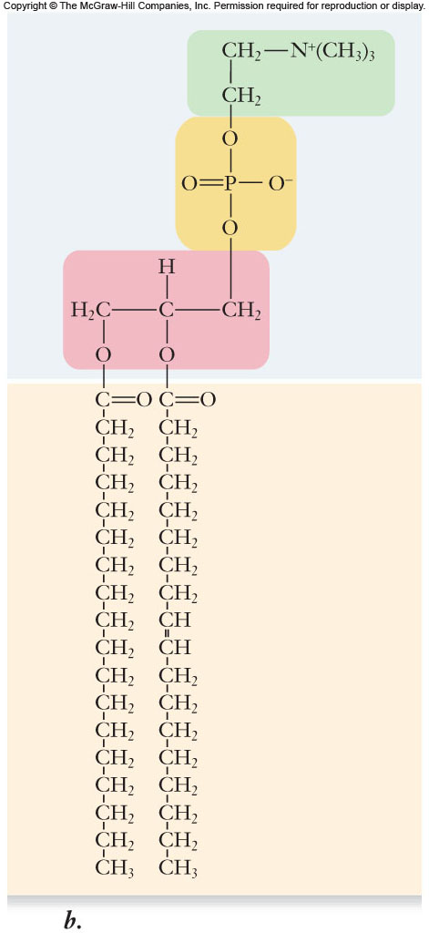
Lipids

Slide 47
Lipids
Phospholipids spontaneously form micelles or lipid bilayers.
  hydrophobic regions toward the inside and hydrophilic regions exposed to the water environment
  Lipid bilayers are the basis of biological membranes.

Slide 48
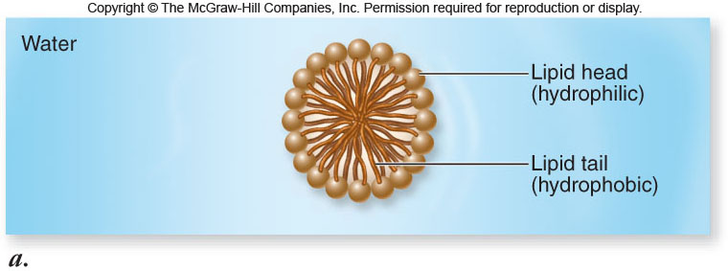
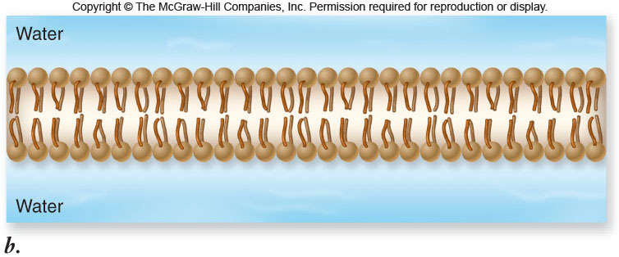
Lipids

Slide 49
Compound lipids are simple lipids combined with other groups
  phospholipids, glycolipids, and lipoproteins
Steroids are compounds with a common organic structure. This structure is called a “perhydrocyclopentanophenanthrene”

Slide 50
STEROIDS
Steroids are anything with a “perhydrocyclopentano-phenanthrene” structure in common.
There are four categories of steroids:

Slide 51
Steroids
adrenocortical hormones are produced by the adrenal glands. They control metabolism of proteins and carbohydrates; also maintain mineral balance.

Slide 52
Steroids
cholesterol is the most abundant steroid. Blood contains about 250 mg of cholesterol. Cholesterol constitutes about 10% of dry brain weight.
  Gallstones are almost 100% cholesterol
  Cholesterol is the starting point of the biosynthesis of many other steroids.

Slide 53
Steroids
bile acids have a role in the digestion of fats. They break up fat so that enzymes my act on them. It has a polar and nonpolar end; acts as an emusifying agent

Slide 54
Steroids
sex hormones regulate sex drives, sex characteristics, etc.
examples:
testosterone; androsterone regulate males’ primary and secondary sex characteristics.
estrone; estradiol regulate menstrual cycle and secondary sex characteristics.
progesterone prepares the uterus for fertilized egg.

